Slide 1
Design Presentation: Spark for Data Science
Owner: Sean Norman
CSA19P | 1 of 2
Session Day/Time: | Day 3, Model, Manage & Secure: 08:00 – 08:45 | Presenters/SMEs: | Presenter: John Doe SME(s): John Doe; Jane Doe
Virtual Format and Software: | Presentation: Single Speaker Presenter, ppt slide presentation, live virtual broadcast via Teams, chat enabled and moderated
Cohort / Breakout Mgmt | No cohorts / breakout activities during this session
Objective of Session: | As a result of attending this, attendees will better be able to…
Existing Sources: | <link to any supporting content sources (if any)>
Learner Content: | <Link to draft ppt slide deck and any other materials that the attendees would be seeing or using as part of this session>
Presenter/ SME Guide Content: | <Link to any supporting materials that are just for the presenter and/or supporting SMEs>
Required Homework + name of session for HW review: | No homework or pre-required content needed for this session

Slide 2
Design Presentation: Spark for Data Science
Owner: Sean Norman
CSA19P | 2 of 2
Session Flow and Detailed Agenda |  | Presenter/SME: | Time
Prework | No attendee pre-work needed for this session | N/A | N/A
Session Introduction | Set context for when this process takes place | <presenter> | 3 mins
Body of the session / discussion, activities, Q&A... | Creating spark pool, importing libs Using Spark to query SQL Pool Notebook capabilities Azure Machine Learning Primer Functionality overview Architecture Synapse job service Spark instances Spark pools Polybase Code-behind experience Notebooks on files in storage Library management - Python Spark ML Microsoft ML for Spark | <presenter> | 25 mins
Session Closing / Homework | Go to break Review timing for break, remind audience to stay signed into the meeting, when session will resume, and what they will be doing next. (Data Loading & Data Lake Organization) | <presenter> | 2 mins

Slide 3
Topics Covered
Creating spark pool, importing libs Using Spark to query SQL Pool Notebook capabilities Azure Machine Learning Primer Functionality overview Architecture Synapse job service Spark instances Spark pools Polybase Code-behind experience Notebooks on files in storage Library management - Python Spark ML Microsoft ML for Spark

Slide 4
Spark for Data Science
CSA19P

Slide 5

Agenda
1 Apache Spark
Overview of Apache Spark.
4 Machine Learning
How to train and deploy models with Synapse.
2 Spark in Synapse
How Spark is utilized within Synapse.
3 Notebooks
Understand the notebook paradigm and how to use them in Synapse.

Slide 6
Apache Spark Overview

Slide 7

Azure Synapse Apache Spark - Summary
Apache Spark 2.4 derivation
Linux Foundation Delta Lake 0.4 support
.Net Core 3.0 support
Python 3.6 + Anacondas support
Tightly coupled to other Azure Synapse services
Integrated security and sign on
Integrated Metadata
Integrated and simplified provisioning
Integrated UX including nteract based notebooks
Fast load of SQL Analytics pools
Core scenarios
Data Prep/Data Engineering/ETL
Machine Learning via Spark ML and Azure ML integration
Extensible through library management
Efficient resource utilization
Fast Start
Auto scale (up and down)
Auto pause
Min cluster size of 3 nodes
Multi Language Support
.Net (C#), PySpark, Scala, Spark SQL, Java

Slide 8
Apache Spark
An unified, open source, parallel, data processing framework for Big Data Analytics
Spark Unifies:
Batch Processing
Interactive SQL
Real-time processing
Machine Learning
Deep Learning
Graph Processing
Spark SQL
Batch processing
Spark MLlib
Machine Learning
Spark Streaming
Stream processing
GraphX
Graph Computation
Spark Core Engine
Yarn
Spark MLlib
Machine Learning
Spark Structured Streaming
Stream processing
http://spark.apache.org

Slide 9
Spark Component Features
Spark SQL
Unified data access: Query structured data sets with SQL or DataFrame APIs
Fast, familiar query language across all your enterprise data
Use BI tools to connect and query via JDBC or ODBC drivers
MLlib & SparkML
Predictive and prescriptive analytics
Machine learning algorithms for:
Clustering
Classification
Regression
etc.
Smart application design from pre-built, out-of-the-box statistical and algorithmic models
Spark Streaming
Micro-batch event processing for near-real time analytics
e.g. Internet of Things (IoT) devices, Twitter feeds, Kafka (event hub), etc.
Spark’s engine drives some action or outputs data in batches to various data stores
GraphX
Represent and analyze systems represented by graph nodes
Trace interconnections between graph nodes
Applicable to use cases in transportation, telecommunications, road networks, modeling personal relationships, social media, etc.

Slide 10
General Spark Cluster Architecture
‘Driver’ runs the user’s ‘main’ function and executes the various parallel operations on the worker nodes.
The results of the operations are collected by the driver
The worker nodes read and write data from/to Data Sources including HDFS.
Worker node also cache transformed data in memory as RDDs (Resilient Data Sets).
Worker nodes and the Driver Node execute as VMs in public clouds (AWS, Google and Azure).
Driver Program SparkContext
Cluster Manager
Node
Node
Node
Cache
Cache
Cache
Task
Task
Task
Data Sources (HDFS, SQL, NoSQL, …)

Slide 11
Spark in Azure Synapse Analytics

Slide 12
Spark Notebook Execution with the Synapse Job Service
User creates Synapse Workspace and Spark pool and launches Synapse Studio.
User attaches Notebook to Spark pool and enters one or more Spark statements (code blocks).
The Notebook client gets user token from AAD and sends a Spark session create request to Synapse Gateway.
Synapse Gateway authenticates the request and validates authorizations on the Workspace and Spark pool and forwards it to the Spark (Livy) controller hosted in Synapse Job Service frontend.
The Job Service frontend forwards the request to Job Service backend that creates two jobs – one for creating the cluster and the other for creating the Spark session.
The Job service backend contacts Synapse Resource Provider to obtain Workspace and Spark pool details and delegates the cluster creation request to Synapse Instance Service.
Once the instance is created, the Job Service backend forwards the Spark session creation request to the Livy endpoint in the cluster.
Once the Spark session is created the Notebook client sends Spark statements to the Job Service frontend.
Job Service frontend obtains the actual Livy endpoint for the cluster created for the particular user from the backend and sends the statement directly to Livy for execution.
AAD
Synapse Studio
Synapse Service
Gateway
Auth Service
Job Service Frontend
…
Resource Provider
Spark API Controller
DB
Job Service Backend
Azure
Instance Creation Service
Spark Plugin
…
DB
DB
Spark Instance
VM
VM
VM
VM
VM
VM

Slide 13
Synapse Spark Instance Creation
Synapse Job Service sends request to Cluster Service for creating clusters per the description in the associated Spark pool.
Cluster Service sends request to Azure using Azure SDK to create VMs (required plus additional) with specialized VHD.
The specialized VHD contains bits for all the services that are required by the Cluster type (for e.g. Spark) with prefetch instrumentation.
Once VM boots up, the Node Agent sends heartbeat to Cluster Service for getting node configuration.
The nodes are initialized and assigned roles based on their first heartbeat.
Extra nodes get deleted on first heartbeat.
After Cluster Service considers the cluster ready, it returns the Livy end-point to the Job Service.
Azure Resource Provider
3
Provision Resources
Spark Instance
2
Create VMs with
Specialized VHD
Subnet
VM – 001
VM – 002
VM – 003
VM – 004
VM – 005
Spark Executors
Spark Executors
Spark Executors
Spark Executors
Hive Metastore
YARN NM - 01
Livy - 01
YARN NM - 02
Zookeeper - 01
Zookeeper - 02
Zookeeper - 03
YARN RM - 01
YARN RM - 02
YARN NM - 03
YARN NM - 04
Node Agent
Node Agent
Node Agent
Node Agent
Node Agent
1
Create Cluster
Synapse Cluster
Service
(Control Plane)
4
Heartbeats
Heartbeat sequence

Slide 14
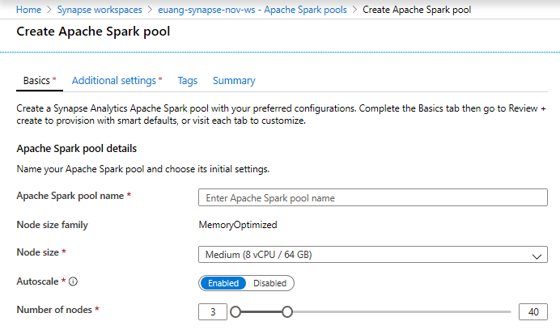
Creating a Spark pool (1 of 2)
Provision Spark Pool through Azure Portal with default settings or per requirements
Basic Settings – Minimum details required from user
Only required field from user
Default Settings

Slide 15
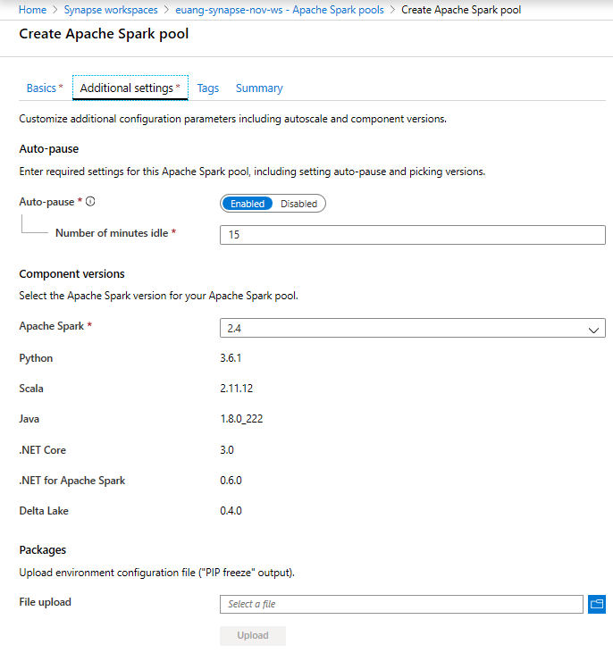
Creating a Spark pool (2 of 2) - optional
Azure Synapse Analytics > Spark > Spark Pool
Additional Settings offer optional settings to customize Spark pool
Customize component versions, auto-pause
Import libraries by providing text file containing library name and version

Slide 16
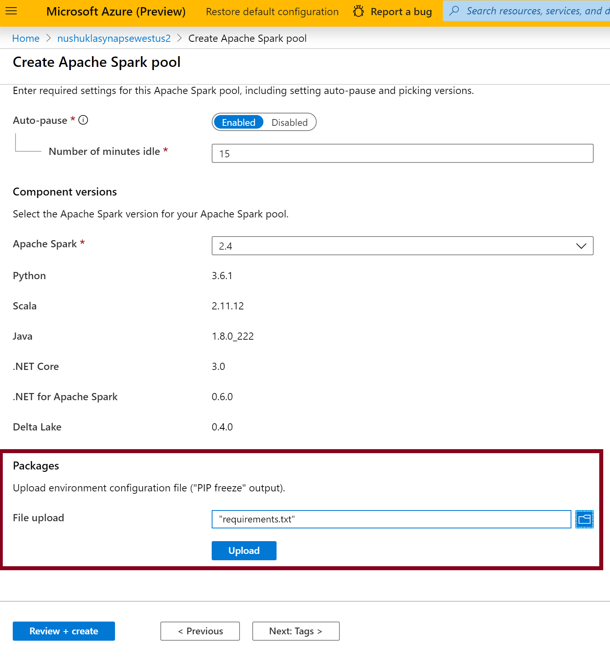
Library Management - Python
In the Portal Specify the new requirements while creating Spark Pool in Additional Settings blade
Overview
Customers can add new python libraries at Spark pool level
Benefits
Input requirements.txt in simple pip freeze format
Add new libraries to your cluster
Update versions of existing libraries on your cluster
Libraries will get installed for your Spark pool during cluster creation
Ability to specify different requirements file for different pools within the same workspace
Constraints
The library version must exist on PyPI repository
Version downgrade of an existing library not allowed

Slide 17
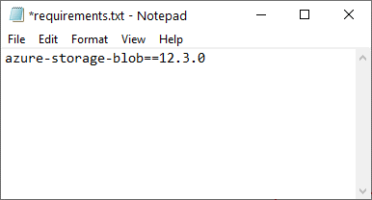
Python Library Requirements Format
Overview
The requirements text file has specific format requirements. These files are traditionally created in Python environments by running the pip freeze command, but are also easy to create by hand.
File must be named requirements.txt.
Each line contains a requirement specifier.
This must contain at least the package name. You can also specify optional extras, an operator and version numbers according to the PIP requirements file standard.
The basic operators used by version specifiers are:
An exact version (using ==).
A minimum version (using > or >=).
A maximum version (using < or <=).
The extras listed in square brackets ([]) allow you to install additional components or variants of the library.

Slide 18
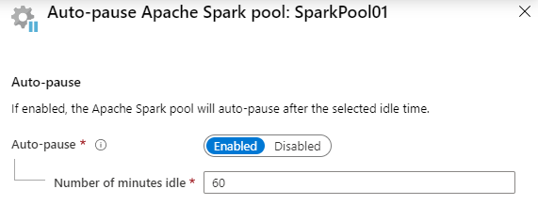
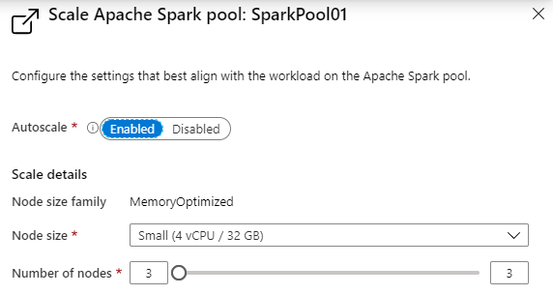
Spark Pools - Configuring
Auto-pause
Enables the pool to automatically stop running when no Spark applications (e.g., Notebooks) are running.
Autoscale
Enables the pool to automatically adjust the number of running nodes (VM’s) supporting the Spark pool.
Note: Just because a pool is running, does not mean all the nodes allowed to run, according to the scale configuration, are actually running. They will be allocated on demand as new Notebooks are executed, up to the limit configured in autoscale.

Slide 19
Notebooks in Azure Synapse Analytics

Slide 20
The Notebook Paradigm – one UI for data science
Collect Data
Retrieve Files
Evaluate
Model
Test Performance
Query SQL Databases
Compare Models
Call Web Services
Validate Model
“Scrape” Web Pages
Visualize Performance
Execute arbitrary:
- Python code
- R code
- SQL queries
- Shell commands
Prepare Data
Explore Data
Deploy
Model
Export Model File
Validate Data
Prepare Job
Clean Data
Deploy Container
Featurize Data
Re-package Model
Notebook
(Synapse Spark)
Train Model
Prepare Training Set
Experiment
Test Model
Visualize Performance

Slide 21

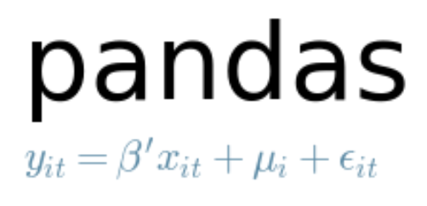

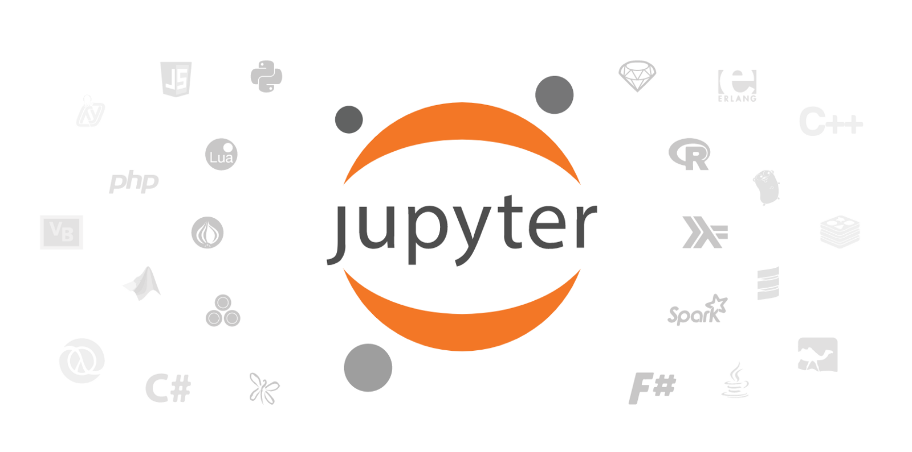


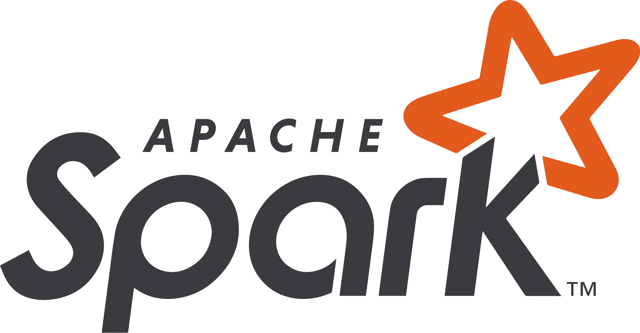
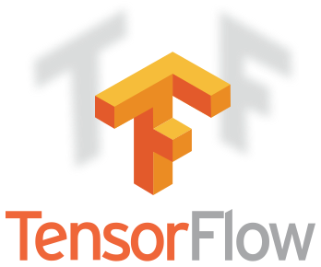
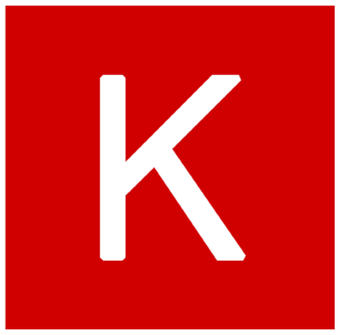

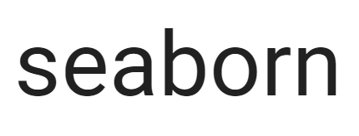


Examples of tools for data science used in Notebooks
Core frameworks and tools
Machine Learning & Deep Learning
Keras
PyTorch
Visualization

Slide 22
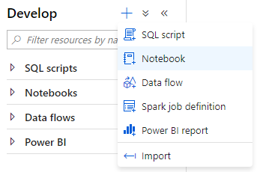
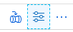
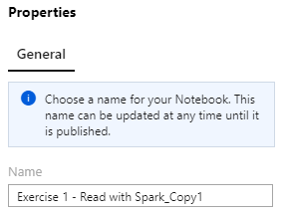
Creating a Notebook
Notebook creating
Create a new notebook within the Develop hub of Synapse Studio.
Notebook naming
The name of the Jupyter notebook can be set in the Properties dialog. It must be set before publishing and cannot be changed later.

Slide 23
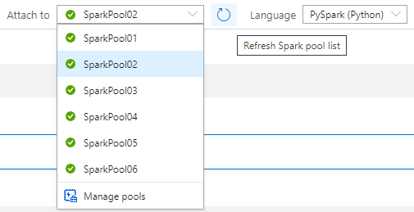
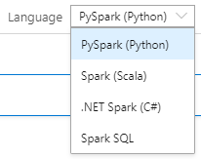
Notebook setup
Selecting the Spark pool to attach to
In the notebook toolbar, select the Spark pool to attach to before running any cells in the notebook.
Notebook default language
The default language used for all cells in the notebook is selected in the Language drop down.
You can override this for any particular cell to use a different language by using the appropriate cell magic (covered later).

Slide 24
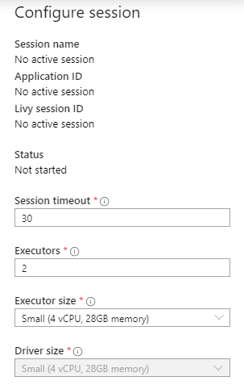
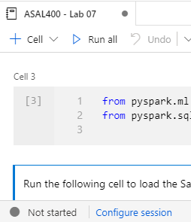
Notebook setup – Session configuration
A Spark session is created upon first run of any cell in a notebook. The configuration for a Spark session can only be set before it is created.
The Spark session allocates one Spark application.
This Spark application consumes a fixed set of resources, as defined in the session configuration. These resources are reserved from the total resources available in the Spark pool upon session start.
Each session reserves resources for at least one driver process and two executor processes. You can configure the size of executors, as well as the number of executors. The size of the driver is always the same as the executors.
A session ends when the notebook is closed or when the session timeout is reached without any activity in the notebook. You can configure the session timeout.

Slide 25
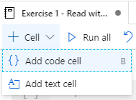
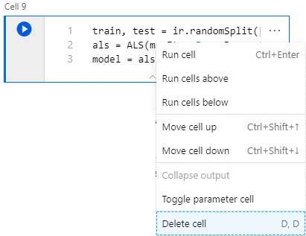
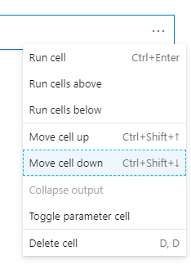
Notebook capabilities – Cell management
Add code or text cells
Remove code or text cells
Adjust cell order

Slide 26
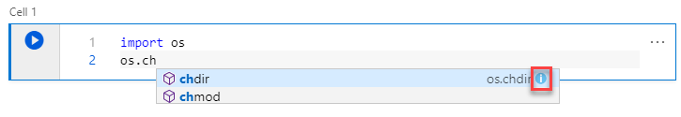
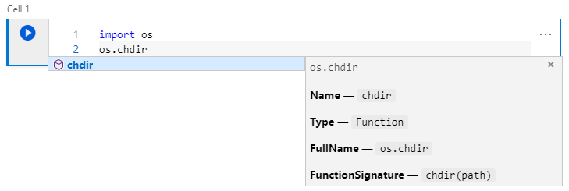
Notebook capabilities – Editing code
Statement completion
Use Ctrl + Space to display
Inline documentation
Select the information tooltip to display

Slide 27
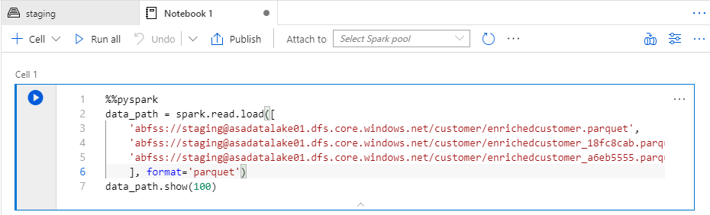
Notebook capabilities – Editing code
Cell magics
Use cell magics to change the language used when interpreting the cell.
These must be the first line in the cell.
Magic | Description
%%pyspark | Execute Python code against Spark Context.
%%spark | Execute Scala code against Spark Context.
%%sql | Execute Spark SQL query against Spark Context.
%%csharp | Execute Spark.NET C# code against Spark Context.

Slide 28
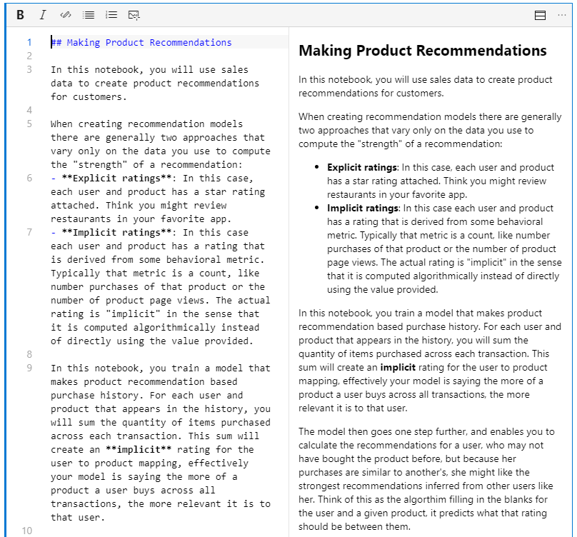
Notebook capabilities – Editing text cells
Support for GitHub flavored markdown
Notebooks support GitHub flavored markdown, enabling limited text formatting, links, lists, code blocks and images.

Slide 29
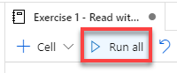
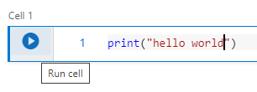
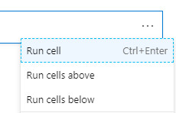
Notebook capabilities – Running cells
Run all cells from toolbar
Run current cell from toolbar from cell itself

Slide 30
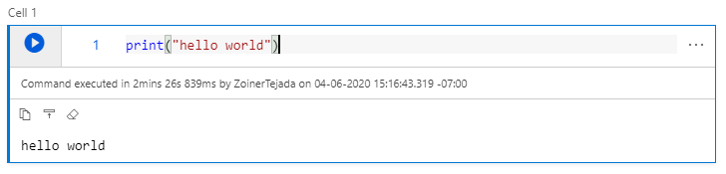
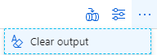
Notebook capabilities – Cell output
Cell output
Clear all cells output from toolbar

Slide 31
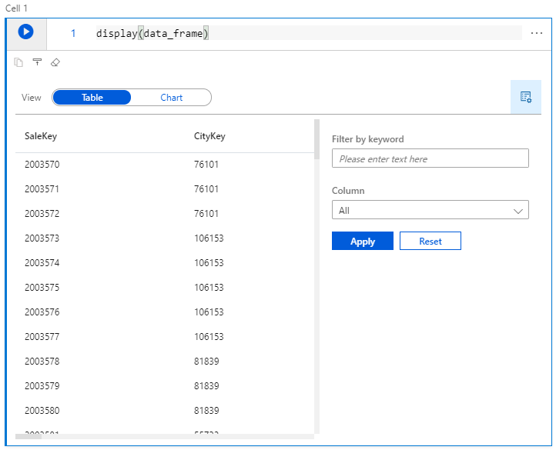
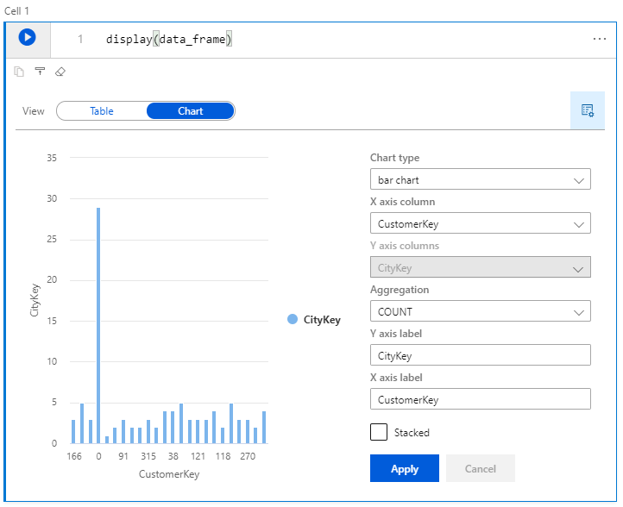
Spark Pools – Notebook capabilities
View DataFrame content as table or chart
Use the display function and pass in your dataframe.

Slide 32
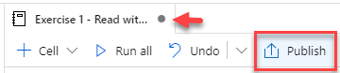
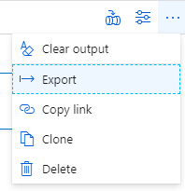

Spark Pools – Notebook capabilities
Saving (publishing)
Exporting (download the .ipynb)

Slide 33
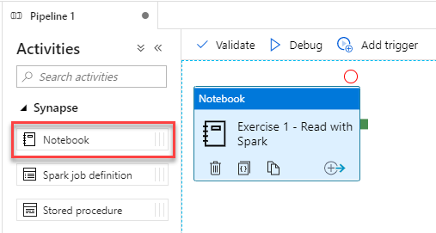
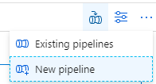
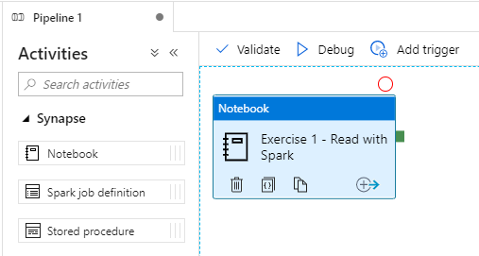
Notebook capabilities – Use in pipelines
Notebooks are pipeline activities
Execute a notebook as a step in a new pipeline

Slide 34
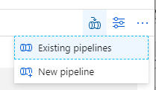
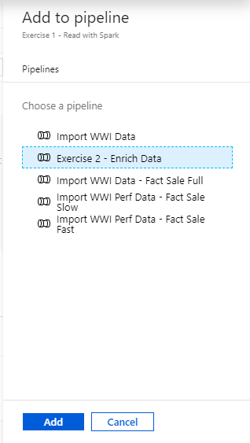
Notebook capabilities – Use in pipelines (2)
Execute a notebook as a step in an existing pipeline

Slide 35
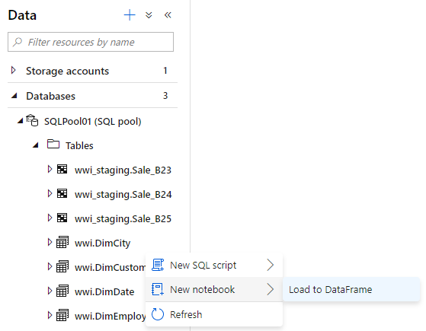
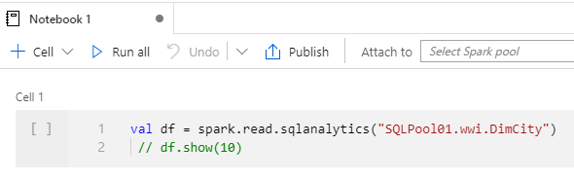
Notebook capabilities – Querying SQL Pools
Loading a SQL Pool table to a DataFrame

Slide 36
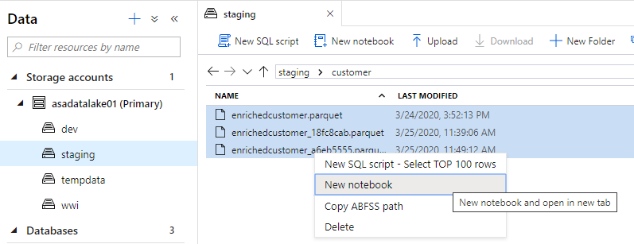
Notebook capabilities – Querying Parquet Files
Loading Parquet files to a DataFrame

Slide 37
Machine Learning in Azure Synapse Analytics

Slide 38




Making predictions with T-SQL
Create the model
Register the model
Use the model
Azure Machine Learning or Azure Synapse Spark
Azure Synapse SQL
Azure Synapse SQL
Notebook
SQL Script
SQL Script
Train Model
Read model
Load model from Table
Convert to ONNX
Load into Table
Use Predict
Export to Storage
Insert Predictions
Storage
Models
Notes:
The diagram illustrates the approach the Azure Synapse Analytics enables for machine learning.
Train the machine learning models using notebooks run within Azure Machine Learning or Azure Synapse Spark. Use the machine learning framework of choice to do so.
Within this notebook, convert the model into the ONNX format and then upload the model to Azure Storage.
From there, run a T-SQL script in Azure Synapse SQL to load the model into a table in the database.
After this, use the model within T-SQL scripts running Azure Synapse SQL by loading the model from the table, and using it with the Predict statement to score data sourced from a table in the database. The scored results could then be used directly or be inserted into a target table for later querying of the predictions.

Slide 39
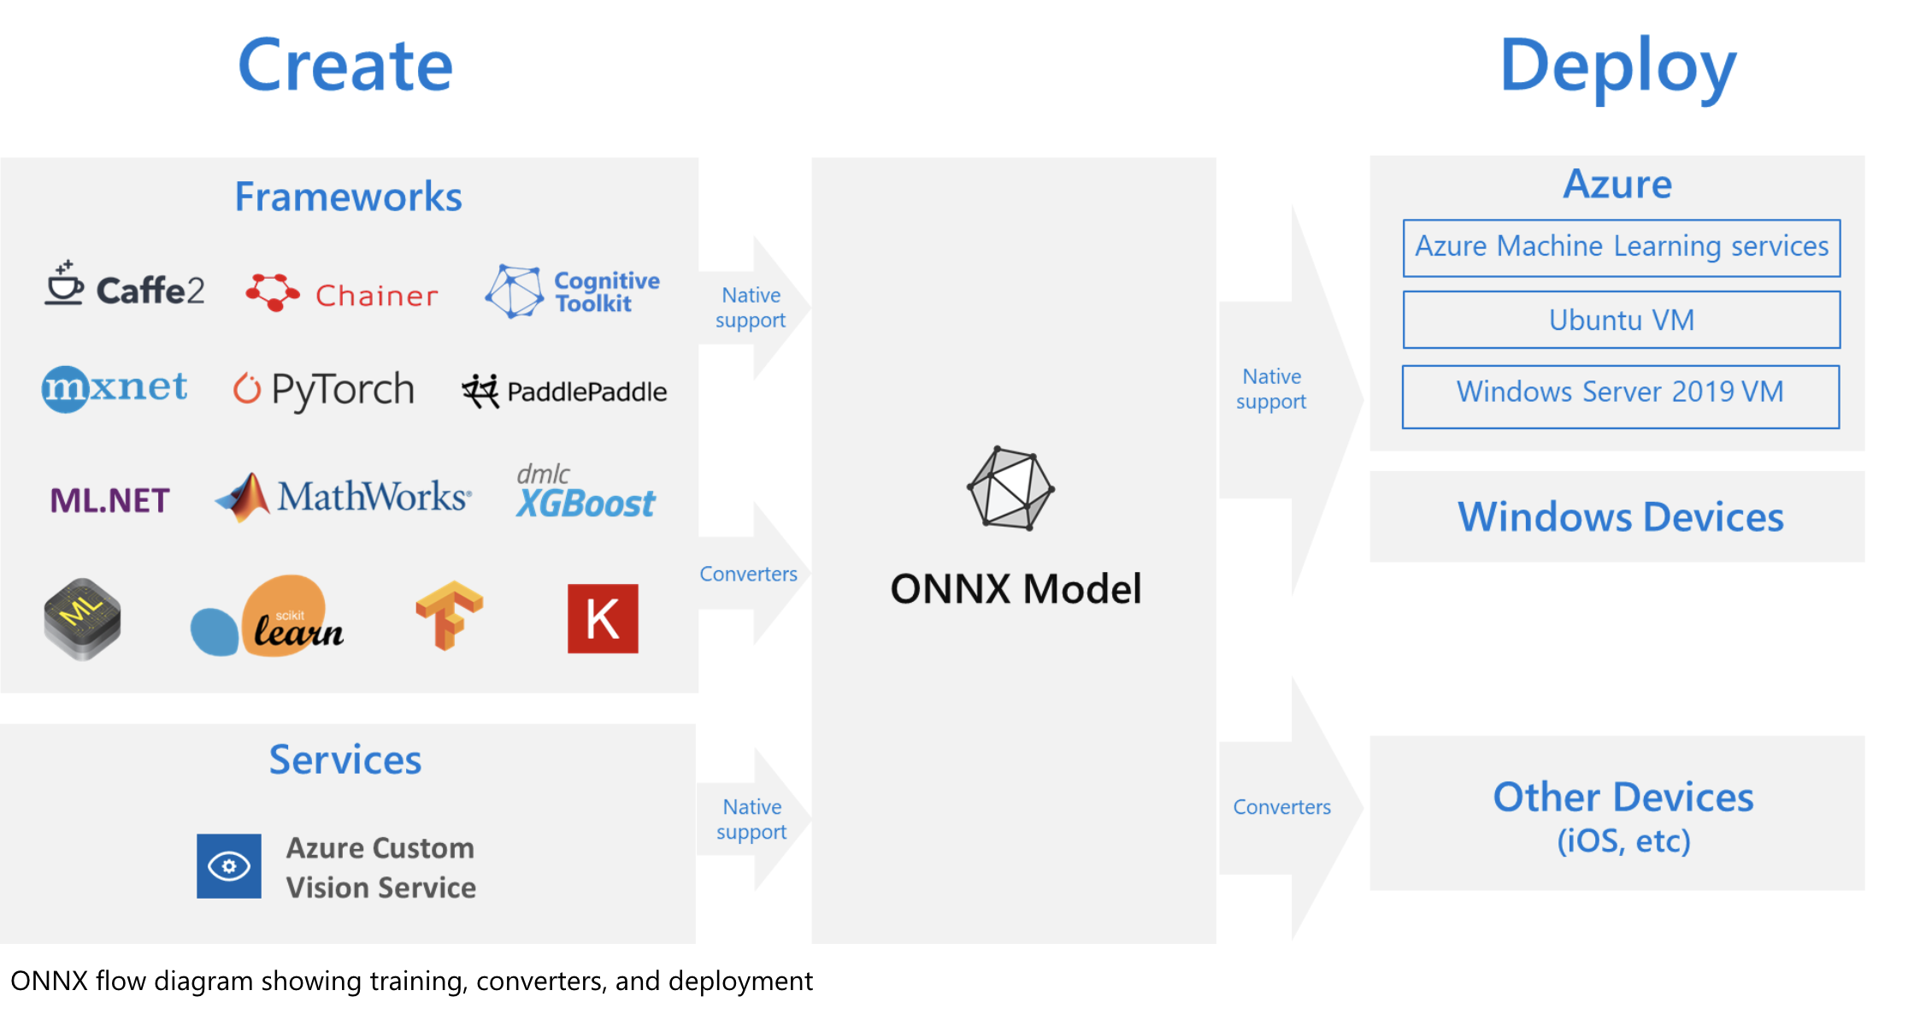
What is ONNX?
Notes:
The challenges of optimizing the performance of machine learning models in production is extremely hard considering the range of hardware capabilities on different platforms such as cloud vs edge, CPU vs GPU etc. and couple that with the variety of frameworks that available for building and training the machine learning models.
To support the idea of providing users the flexibility to train their machine learning models on framework of their choice, and run that model anywhere with optimal performance, is at the core of Open Neural Network Exchange (ONNX) format for representing machine learning models. ONNX is an open format, that is supported by a community of partners, including Microsoft, who create compatible frameworks and tools.
You can create ONNX models from many frameworks, including PyTorch, Chainer, Microsoft Cognitive Toolkit (CNTK), MXNet, ML.Net, TensorFlow, Keras, SciKit-Learn, and more. ONNX Runtime is optimized for both cloud and edge and works on Linux, Windows, and Mac, and it also integrates with accelerators on different hardware such as TensorRT on NVidia GPUs. ONNX models can be deployed to the cloud using Azure Machine Learning and ONNX Runtime. They can also be deployed to Windows 10 devices using Windows ML. They can even be deployed to other platforms using converters that are available from the ONNX community.
The interoperability you get with ONNX makes it possible to get great ideas into production faster. With ONNX, data scientists can choose their preferred framework for the job. Similarly, developers can spend less time getting models ready for production, and deploy across the cloud and edge.
Data scientists: use the framework of their choice to create and train models
Developers: deploy models cross-platform with minimal integration work

Slide 40
Thank You slide
Thank you

